Slide 1
Supermarket data analysis
Presented by : Aniket Kolkar

Slide 2
Introduction to Project
AJ Ecom Pvt Ltd is one of the leading business company who have supermarkets across different regions of India.
Their goal is to understand the performance of their supermarkets in terms of customers, products and its sale.

Slide 3
Goals of the project
Visualise the given dataset by defining problem statements
Problem statements:
Identify gender bias in dataset
Sale’s amount distribution
Impact of different age groups on product purchase
Top 10 customers
Product category preferred by customers
Product subcategory preferred by customers
Sales variance over months
Store type preferred by customers
Customers distribution based on age group
Peek weekdays for the company

Slide 4

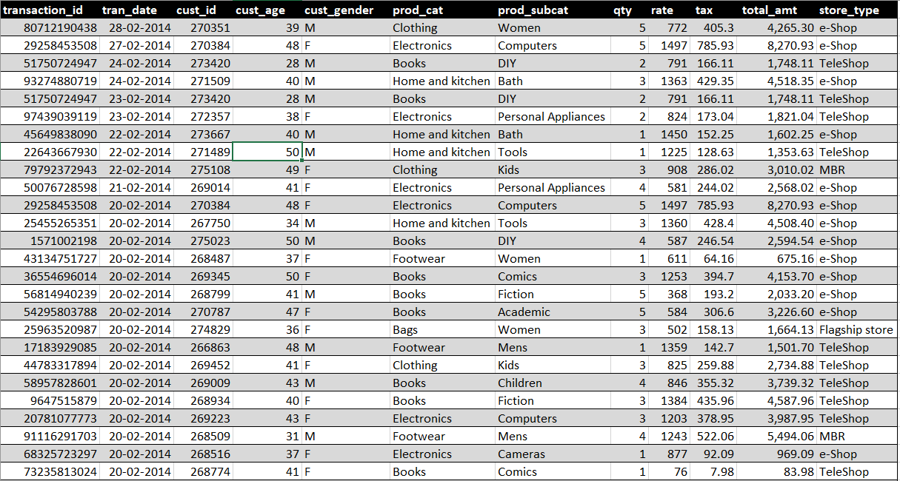
Dataset Preview

Slide 5
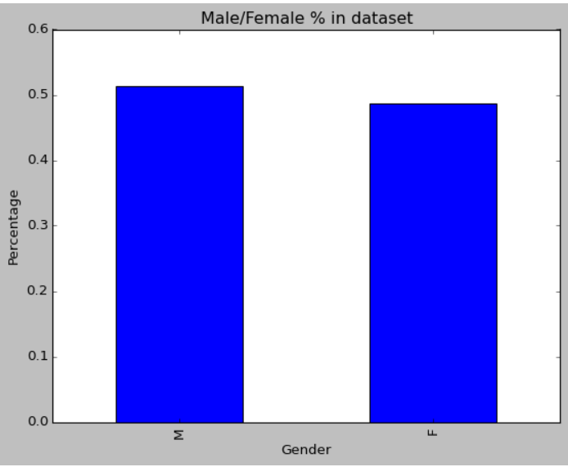
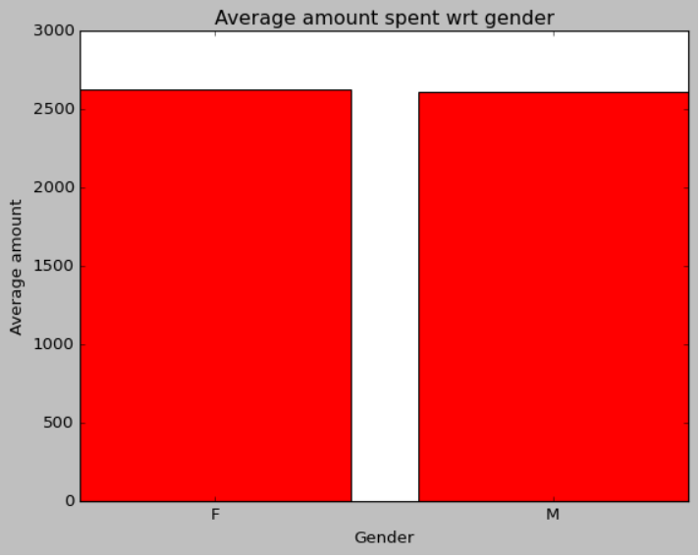
Identifying gender bias in Dataset
The top graph shows male percentage is slightly higher than female
The bottom graph shows male and female spent nearly equal amount for purchase

Slide 6
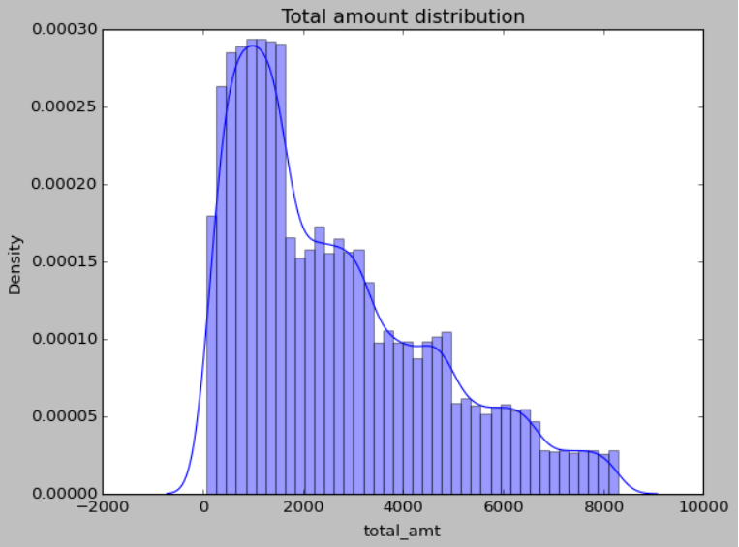
Sale’s amount distribution
Products having price within range of 100-2000 sold in maximum amount

Slide 7
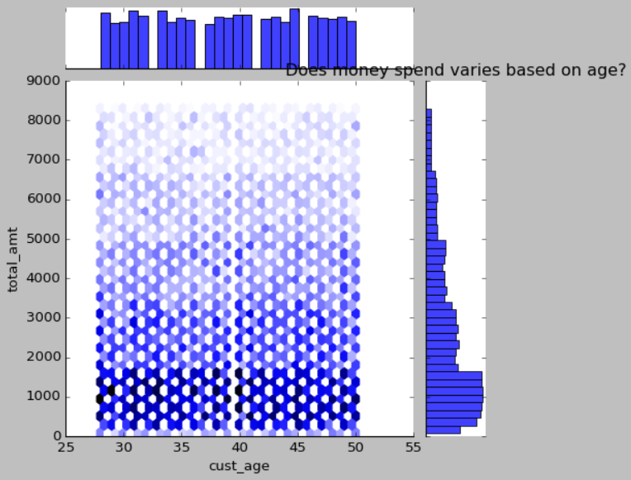
Impact of different age groups on product purchase
No significant impact of age group on purchase made by customer
All age group spent nearly equal amount

Slide 8
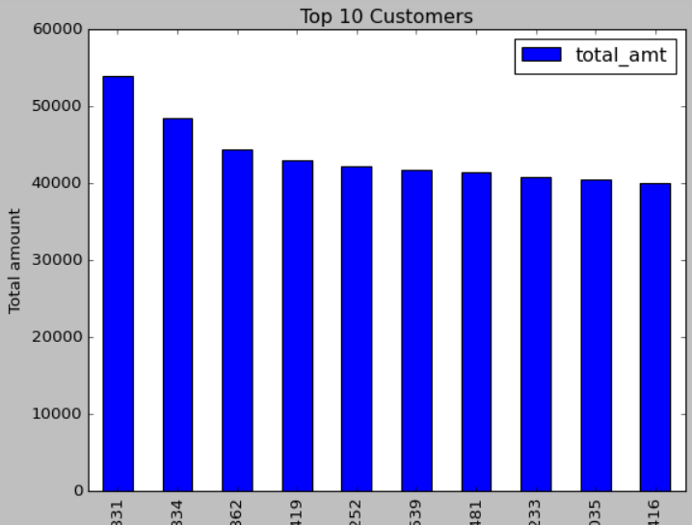
Top 10 customers
The top 10 customer ids
Company should focus on these customer(Prime member)

Slide 9
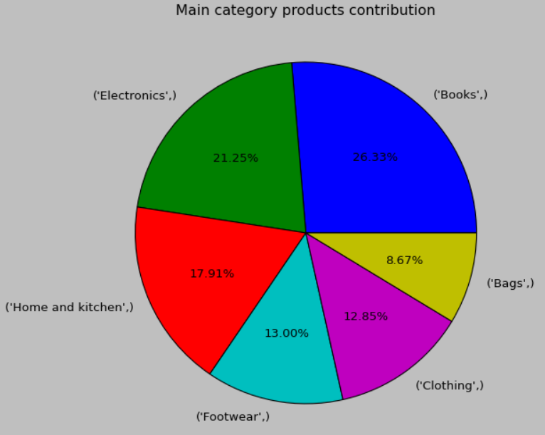
Product category preferred by customers
‘Books’ and ‘Electronics’ category preferred by customers

Slide 10
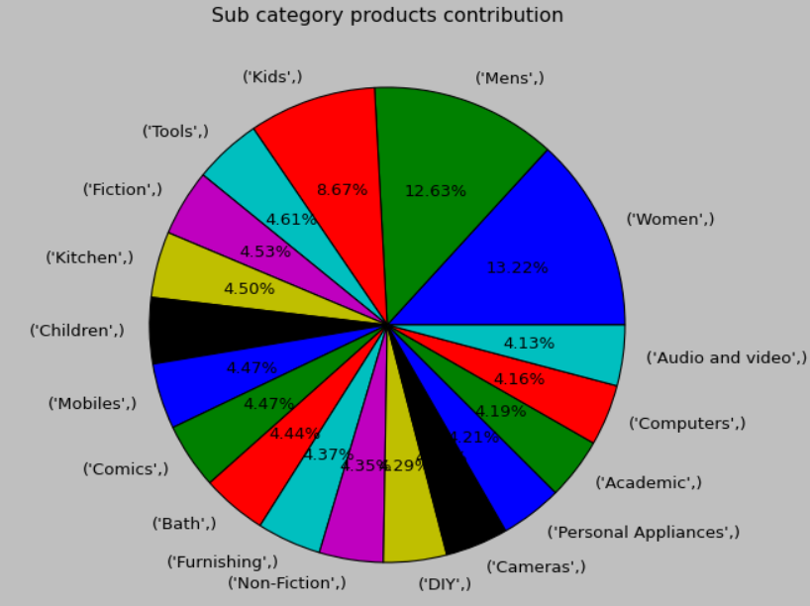
Product Subcategory preferred by customers
‘Men’, ‘Women’ and ‘Kids’
These subcategories are preferred by customers

Slide 11
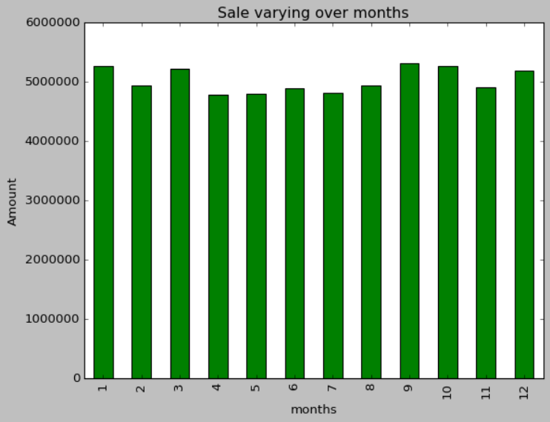
Sales variance over months
Last quarter of the year is profitable duration for the company

Slide 12
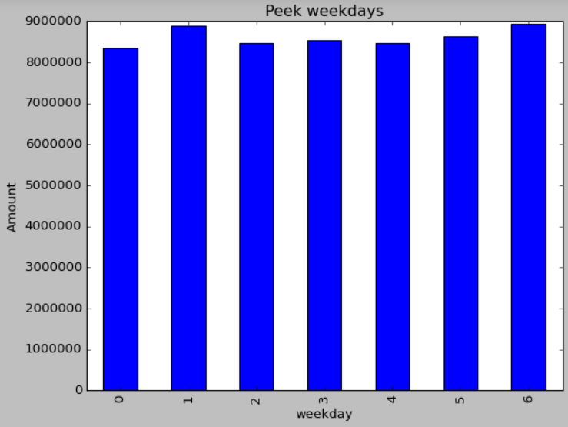
Peek weekdays for the company
Monday and Saturday
These are peak weekdays for the company

Slide 13
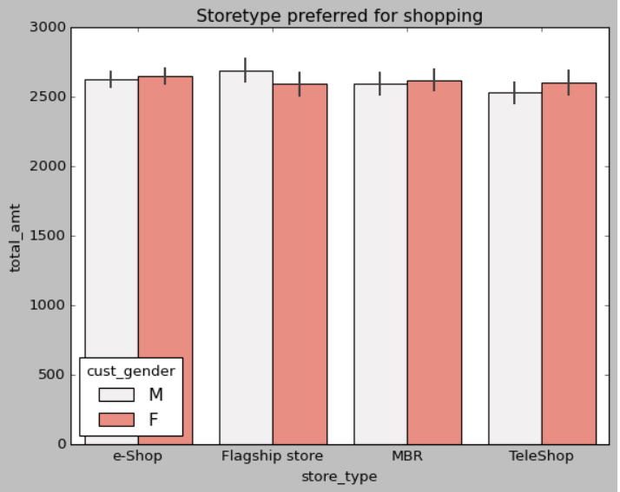
Store type preferred by customers
On an average, flagship type of stores are preferred by males for shopping
E-shopping is majorly preferred by women

Slide 14
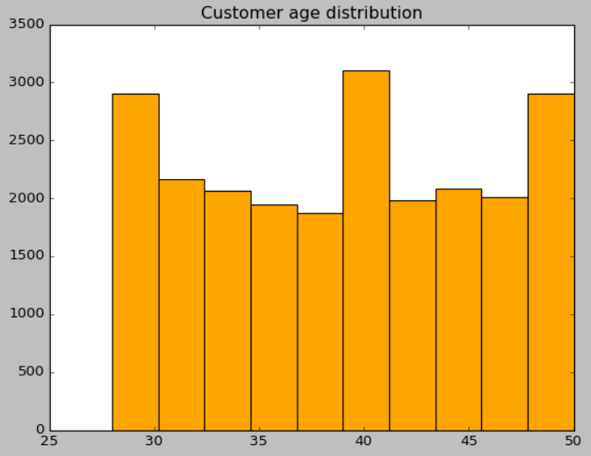
Customers distribution based on age group
Customer having age around 29, 40 & 50 do shop more Amount

Slide 15

Insights and conclusion
In the given dataset there is no gender bias which means shopping of both the gender is nearly equal
Products which are having price in range of 100-2000 is sold in more quantity
No significant impact of customer age on purchase of the product, means amount spent by group of all ages category is nearly equal
Company should focus on top10 customer(Prime member)
‘Books’ and ‘Electronics’ category product sold in more quantity
‘Men’, ‘Women’ and ‘Kids’ subcategory products sold in more quantity
Last quarter of the year is more profitable duration for the company
Monday and Saturday are peak weekdays for the company
Men prefers shopping at flagship store and women prefers e-shopping
Customers having age around 29, 40 and 50 year do shop in more quantity

Slide 16
Thank you

